Slide 1
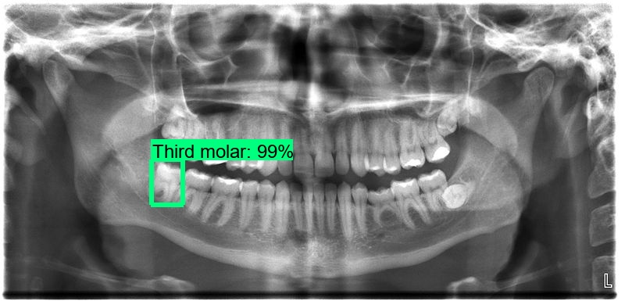
Step 1
Finding the tooth from the whole mouth or multiple teeth.

Slide 2
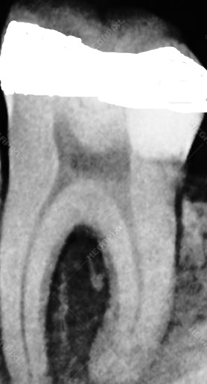
Step 2
Segregate the identify tooth which has filling in the whole mouth.

Slide 3
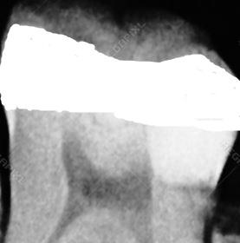
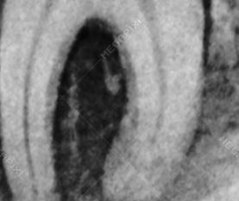
Step 3
Divide the tooth into two parts i.e. one of the upper part of black and other lower part.

Slide 4
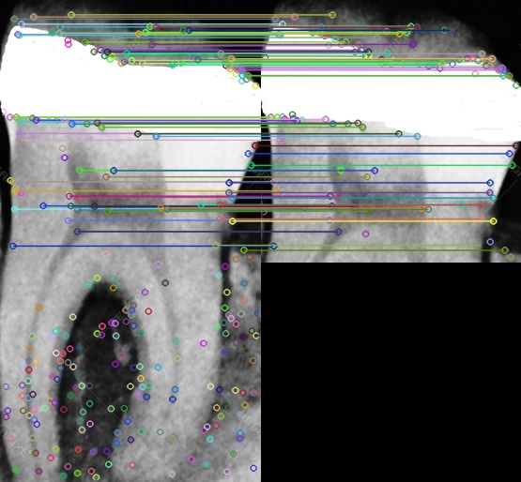
Step 4
Compare the upper half part from the whole image.

Slide 5
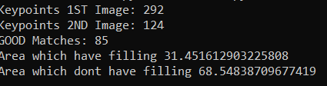
Step 5
Finding the area which has filling and which doesn’t have.

